Slide 1
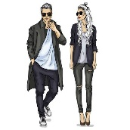
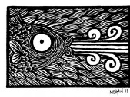
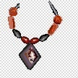
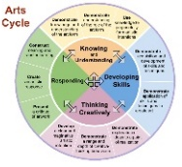
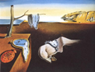
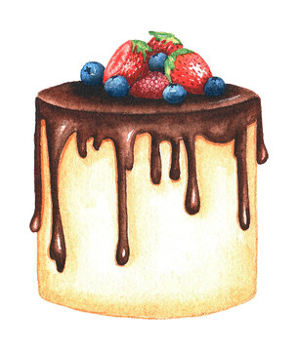
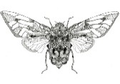
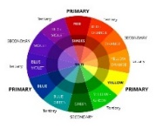
I
Creative Arts
Go to university to enhance your studies and get a degree
Start a degree level apprenticeship
Learning Journey
ART
Foundation Studies in Art
BA Fine Art
Continue your lifelong love of learning and personal development
Gallery Curator
Fashion Designer
BA Visual Arts
Art Buyer
Illustrator
Graphic
Designer
Tattoo artist
Component 1
Sustained Project
Fine Art – Natural Forms
Arts Journalist
Set Design
Take a gap year, travel the world and embrace new cultures
Games Design
Architect
Textile Designer
AO2:Refine work by exploring ideas, selecting and experimenting with appropriate media, materials, techniques and processes.
Interior Design
Arts Marketing
Component 2
10 Hour
externally set task
AO4: Present a personal and meaningful response that realises intentions and demonstrates understanding of visual language
Fashion Design
Visual Arts
Ceramics
Model Making
Theatre and Film Design
Targeted critical development workshops, trips and visiting speakers
Externally set assignment
10 hour supervised assessment period
Career Opportunities
Photography
AO1:Develop ideas through investigations, demonstrating critical understanding of sources
AO3: Record ideas which give insight to relevant intentions as work progresses
Jewellery Design
Trips and Visiting
Artists
Completion of exam
Review, Select and Present Portfolio folder
Printmaking
AO4: Refine and present ideas through a personalised visual journey
AO3: Record ideas, observations and insights relevant to intentions as work progresses.
AO3:Intergrate the use of drawing and written annotation.
AO1: Explore a prescribed area of study in a personal manner
A02: extend their understanding and skills with application of suitable materials, process and techniques
YEAR
Sustained
Phase
11
Development
Phase
AO4: Present a personal and meaningful response
AO1: Develop ideas through investigations demonstrating critical understanding of sources
A04:Resolve investigations through the creation of a personal piece.
AO2: Ability to refine ideas thoughtfully and purposefully experiment with different media and techniques
AO2: Refine work by exploring ideas, selecting and experimenting with different techniques and materials.
A03: Develop and record a creative journey
You now understand the FORMAL ELEMENTS of ART and are using your ART VOCABULARY
Evaluate: Make connections with the world around us and how this inspires artists and designers
Design: Recall your experience and knowledge so far to investigate, explore and experiment – freedom of design
Make your informed GCSE option choices
YEAR
10
Introductory
Phase
AO1: Make connections with the work of artists, crafts people and designers
Design: Using inspiration from Surrealism and information from their cultural background to create a personal composition.
Explore: Surrealism and artist links e.g. Salvador Dali
Make, Design, Respond
INDEPENDENTLY
Evaluate: Recording your creative journey
Introduction to learning aims and task breakdown provided.
Design: Develop understanding of composition
Start your GCSE
Course
Time
Term 3
Make: Explore
techniques and
media
Evaluate: Explain final ideas with connections to the artist
Evaluate: Modify final Ideas with next steps
Make: Develop and recall Design Cycle – create own ideas and refine them
Build on and develop skills which will refine past learning by selecting and experimenting with new media, materials, techniques and processes.
Cakes and Sweets
Term 2
Evaluate final design with advantages and disadvantages with support
Design: Using research and exploration from media to inspire ideas
Materials: paint, crayon, mono printing
Materials: Explore
Surface and texture
Design: Using artist influences to inspire ideas.
Introducing Formal
Elements Texture & Form
Natural Forms
Insects
Term 1
Materials: Recognise properties of Paint
Evaluate: Test and Refine Ideas
Explore: understand what Day of the dead represents.
YEAR
You will be using the colour theory to develop your understanding of the use of warm, cool and tertiary colours
Make: Develop tone
with mark making,
colour and pencil
Materials: Explore mono print process
9
Colour Theory
Term 1
Pop Art
Term 2
Day of the Dead Printmaking
Text & Image
Term 3
YEAR
Make: Develop and recall linking own work with artists
8
Design: using tints, tones and shades producing a composition of warm and cool colours
Make: a selection of logos inspired by artists and printmakers
Design: Using research and exploration from media to inspire ideas
Evaluate: Annotate and compare final design
Design: and produce an African Mask
Work on more in- depth projects, honing your practical skills, improving your resilience and problem solving whilst developing independence in the Art studio.
Design: Explore and Experiment with model making
Design:
Understanding visual research and exploring different images related to the sea.
Design: Explore and Experiment Line and Shape
Design: Explore and Experiment Colour Theory
Introducing Formal Elements Line & Shape
Introducing Formal Elements Colour & Pattern
Africa
Term 3
The Blue Planet
Term 2
Formal
Elements
Term 1
YEAR
Get
Creative
Design: researching African Masks
7
Materials:
Remember colour mixing
Make:
Demonstrate mark making and observational recording skills
Make: Explore initial design drawing
Make: Discover colour wheel
Materials:
Explore different properties of Pencils and crayons
Experience a wide range of fun and exciting projects that help you build valuable skills in the Art studio, understanding different materials and how you can use the
them
Make: Produce a final response
Make: Produce a final response
Make: Explore line, tone, texture,
and colour

