Slide 1
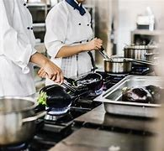
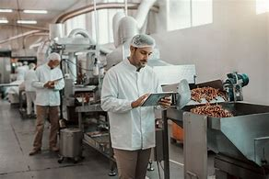
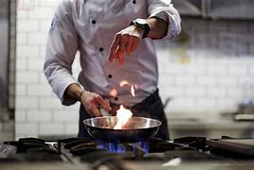
I
Creative Arts
Go to university to enhance your studies and get a degree
Start a degree level apprenticeship
Learning Journey
Design & Technology
Level 3 Professional Cookery
BSc Culinary Arts
Street Food trader
Waiter
Level 1/2 Hospitality
& Catering
Continue your lifelong love of learning and personal development
BSc
Bakery &
Patisserie
House
Keeper
Food Photographer
Microbrewer
Wedding planner
Unit 1
The Hospitality
& Catering industry
40% 1hour 20 min exam
Restaurant
Manager
Publican
Take a gap year, travel the world and embrace new cultures
Personal chef
Executive chef
Food Journalist
Hotel Manager
Unit 2
Hospitality
& Catering in action
60% 12 hours assessment
Home Economist
Arts Marketing
Food Critic
Food
Scientist
Unit 2 Assignment Tasks 3 & 4
Assignment Task 3: preparation, cooking and presenting 3 dishes selected for the assignment brief.
Assignment task 4: assess the production of the presented dishes; review own performance.
Food preparation, cooking, analysis and evaluation.
Catering manager
Food manufacturing inspector
Term 3
Revision of all topics studied.
Food preparation, cooking, analysis and evaluation.
1 hour 20 minutes written exam.
Career Opportunities
Fish monger
Term 2
Barista
Butcher
Unit 2 Assignment Tasks 1 & 2:
Analyse the assignment brief.
Explain the impact of cooking methods.
Address nutritional factors.
Production planning.
Food preparation, cooking, analysis and evaluation.
Completion of exam
YEAR
The importance of nutrition.
Menu planning.
Revision of material studied.
Preparation for year 11’s assessment tasks.
Food preparation, cooking, analysis and evaluation.
Operation of Front and Back of House; safety and security.
Catering for customers’ needs, requirements and expectations.
Customer rights.
Local residents.
Health & Safety laws.
Food Safety Act.
The Environmental Health Officer.
Food preparation, cooking, analysis and evaluation.
Term 1
11
Term 3
Developing use of clay
Term 2
YEAR
Gaudi Mosaic Mirror
10
Start your
GCSE Course
Structure of the Hospitality & Catering Industry.
Job roles; skills, attributes and dress code.
Working conditions & employment rights.
Factors that make successful businesses.
Environmental factors.
Heath and Safety in H&C.
Food Safety in H&C.
Food preparation, cooking, analysis and evaluation.
Antoni Gaudi
Term 1
Mosaic
Wood joints
Moulds & Parasites
Ceramics
Term 2
Bacteriology
De Stilj
Modelling
Islamic tile art
WJEC Level 1/2 Hospitality & Catering
Making your KS4 Options
Food Safety in H&C
Food
Term 2
Trinket Box
3D Design
Term 1
Allergens
Food intolerances
Art Nouveau
Recycling materials
YEAR
AQA A&D Three-Dimensional Design
Presentation techniques
9
Neurographical Art
Electronics
World Foods
Using a heat press
3D Design
Term 1
Sustainable Lamp
Food
Term 2
World Foods
Textiles
Term 3
Tablet Beanbag
Using a sewing machine
YEAR
8
Sustainability
Using the laser cutter
Methods of cooking
Dish
blueprint task
Memphis Group
Model making
Eatwell Guide
Transfer dyes
CAM knowledge
Wacky Racing Car
Hygiene
Basic electronics
Biomimicry
3D Design
Term 3
Kitchen Basics
Food
Term 2
Product Design
Term 1
YEAR
Get
Creative
Mini Torch
7
Workshop Health & Safety
Sensory Analysis
Health & Safety
Packaging
Alessi Group

