Slide 1
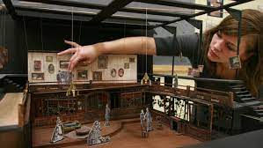
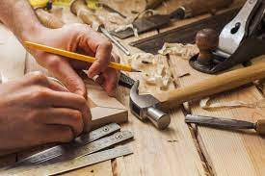
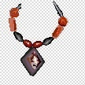
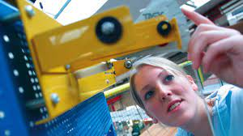
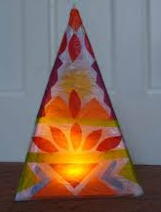
I
Creative Arts
Go to university to enhance your studies and get a degree
Start a degree level apprenticeship
Learning Journey
Design & Technology
Foundation Studies in Art & Design
BSc Product Design
Mechanical engineer
3D Design
Continue your lifelong love of learning and personal development
BSc Architectural Design & Technology
Civil Engineer
Robotics engineer
Illustrator
Graphic
Designer
Industrial
Designer
Art
Director
Component 1
Sustained Project
3D –Storage
Set Design
Take a gap year, travel the world and embrace new cultures
Civil Engineer
Interior Design
Architect
Carpenter
Component 2
10 Hour
externally set task
AO2:Refine work by exploring ideas, selecting and experimenting with appropriate media, materials, techniques and processes.
AO4: Present a personal and meaningful response that realises intentions and demonstrates understanding of visual language
Mechanical Engineer
Arts Marketing
Ceramics
Visual Arts
Model Making
Theatre and Film Design
Targeted critical development workshops, trips and visiting speakers
Externally set assignment
Personal choice of one brief set by AQA
10 hour supervised assessment period
Career Opportunities
Photography
AO1:Develop ideas through investigations, demonstrating critical understanding of sources
AO3: Record ideas which give insight to relevant intentions as work progresses
Jewellery Design
Trips and Visiting
Artists
Completion of exam
Review, Select and Present Portfolio folder
Printmaking
AO4: Refine and present ideas through a personalised visual journey
AO3: Record ideas, observations and insights relevant to intentions as work progresses.
AO3:Intergrate the use of drawing and written annotation.
AO1: Explore a prescribed area of study in a personal manner
A02: extend their understanding and skills with application of suitable materials, process and techniques
Storage
YEAR
AO4: Present a personal and meaningful response
Sustained
Phase
11
Puppet project
Development
Phase
A03: Develop and record a creative journey
AO1: Develop ideas through investigations demonstrating critical understanding of sources
A04:Resolve investigations through the creation of a personal piece.
AO2: Ability to refine ideas thoughtfully and purposefully experiment with different media and techniques
Frame project
AO2: Refine work by exploring ideas, selecting and experimenting with different techniques and materials.
Developing use of clay
YEAR
Gaudi Mosaic Mirror
10
Start your
GCSE Course
Introductory
Phase
Lamp project
AO1: Make connections with the work of artists, crafts people and designers
Antoni Gaudi
Mosaic
Introduction to learning aims and task breakdown provided.
Wood joints
Moulds & Parasites
Ceramics
Term 2
Bacteriology
De Stilj
Modelling
Islamic tile art
WJEC Level 1/2 Hospitality & Catering
Making your KS4 Options
Food Sa fety in H&C
Food
Term 2
Trinket Box
3D Design
Term 1
Allergens
Food intolerances
Art Nouveau
Recycling materials
YEAR
AQA A&D Three-Dimensional Design
Presentation techniques
9
Neurographical Art
Electronics
World Foods
Using a heat press
3D Design
Term 1
Sustainable Lamp
Food
Term 2
World Foods
Textiles
Term 3
Tablet Beanbag
Using a sewing machine
Sustainability
Using the laser cutter
Methods of cooking
Dish
blueprint task
Memphis Group
Transfer dyes
CAM knowledge
Wacky Racing Car
Model making
Eatwell Guide
Hygiene
Basic electronics
Biomimicry
YEAR
8
YEAR
Get
Creative
3D Design
Term 3
Kitchen Basics
Food
Term 2
Mini Torch
Product Design
Term 1
7
Workshop Health & Safety
Sensory Analysis
Health & Safety
Packaging
Alessi Group

