Slide 1
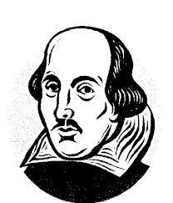
ENGLISH
Baseline assessments
Week 1-2 –
SPAG
Transition
Grammar Consolidation
Learning Journey
Week 3-8
Dreams and Nightmares
Monster Calls
Checkpoint
Week 15-16
Fantasy setting
Transition
Week 9-13
Dreams and Nightmares Gothic Writing
Week 17-20
Love and Relationships
War poetry focusing on relationships
Creative writing and exploration
Week 21-25
Love and Relationships Transactional writing focusing on letters, articles and speeches
Checkpoint
Week 26 - 31
Love and Relationships Twelfth Night
Week 32-37
Holes
Checkpoint
Transactional writing & Twelfth Night
Week 38 - 40
Spoken Word - Poetry
Extracurricular
YEAR 7 :

Slide 2
ENGLISH
Learning Journey
Week 1-2
Identity in Media
Transition
Week 3-8
Changing the World
Non-Fiction Writing
Letters, articles, speeches
Week 17 – 20
Gender in Literature
Narrative writing
Week 16
Leadership and Voice
Transition
Animal Farm & transactional writing
Week 9 - 15
Changing the World
Animal Farm
Checkpoint
Week 21 – 26
Gender in Literature Romeo & Juliet
Week 27-32
Gender in literature
Poetry – character and place
Week 33 – 37
The Boy in the Stiped Pyjamas
Week 38-39 Spoken Word
Checkpoint
Checkpoint
Exploring Viewpoints
Week 40 Extra curricular
Poetry, Romeo and Juliet & Creative Writing
YEAR 8 :

Slide 3
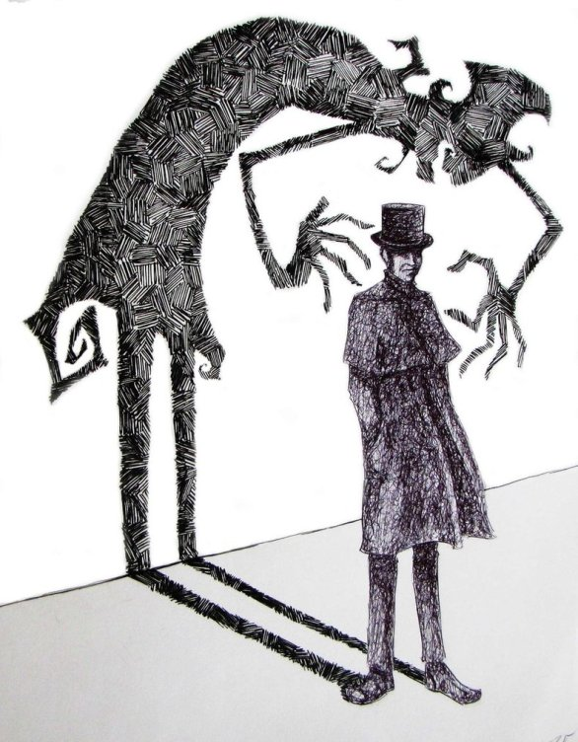
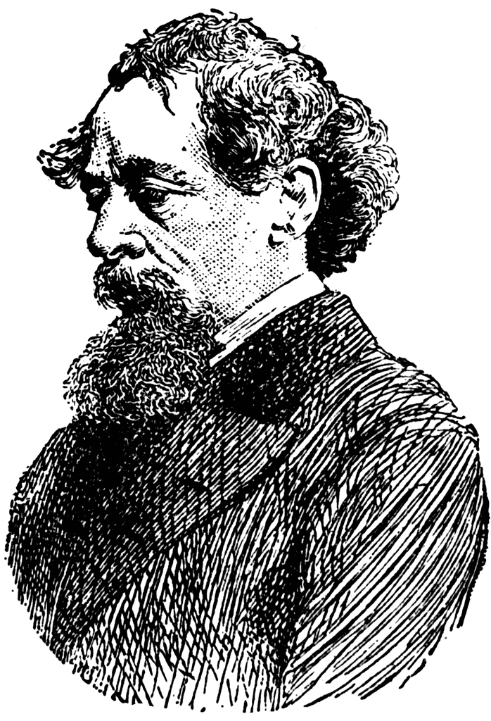
ENGLISH
Week 1-2
Grammar is Power
Retrieval Prior learning Skills
Transition
Learning Journey
Week 3-8
Utopia and dystopia
fiction extracts
Creative writing
Week 18 - 20
Dickens and Darker society
Transition
Creative writing and Explorations
A Christmas Carol
Week 21 – 25
Poetry
Identity/ culture
Week 9 - 15
A Christmas Carol
Checkpoint
Week 26 – 32
Non-fiction reading & writing
Week 38 - 39
Spoken Word
Week 33 – 37
Of Mice and Men
Checkpoint
Exploring Viewpoints
Poetry
Week 40 - Extra curricular
YEAR 9 :

Slide 4
ENGLISH
Learning Journey
Week 1 –
Macbeth Context
Transition
Week 9 - 15
Language paper 1
Reading & Writing
Week 2-8
Macbeth
Language paper 1 (reading & writing)
Macbeth
Week 21 – 25
Language paper 2 –Reading and writing
Week 16 – 20
An Inspector Calls
Checkpoint
Week 33 - 34
Revision Language Paper 1 & 2
Week 26 -31
Power & conflict
Week 32
Unseen Poetry
Week 37-39
speaking listening endorsement
Checkpoint
Language paper 1 & 2 (reading & writing)
Literature Paper 2 (AIC, P&C, Unseen poetry)
Macbeth
Week 40
Extra curricular
YEAR 10 :

Slide 5
ENGLISH
Learning Journey
Week 1-5
An Inspector Calls
Week 9 - 13
A Christmas Carol
Week 6-8
Language Paper 1
Reading & Writing
Language paper 1 (reading & writing)
An Inspector Calls
Checkpoint
Week 16-17
Language paper 2 –Reading and writing
Week 14-15
Macbeth
Week 26-29
Revision Language Paper 1 & 2
Revision Literature 1 & 2
Week 18-22
Power & Conflict Poetry
Week 24-25
Unseen Poetry
Week 3035
External Examinations
Checkpoint
Language paper 1 & 2 (reading & writing)
Literature Paper 1 & 2 (AIC, P&C, Macbeth, ACC, Unseen Poetry)
YEAR 11 :

