Slide 1





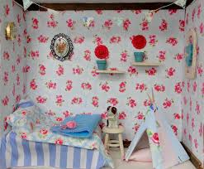



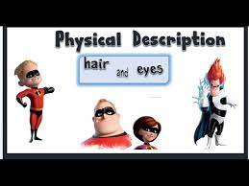

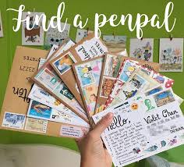


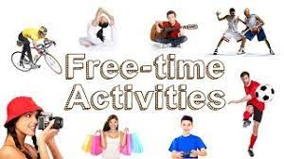

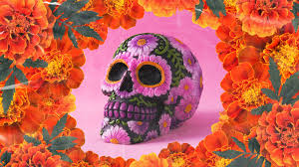





Learning Journey Map
YEAR 7 SPANISH
Year 7 Survival Top Tips
Tip 1 | Learn and revise vocabulary regularly, approximately 10 words a week.
Tip 2 | Revise little and often: aim to do 15 minutes of practice a day.
Tip 3 | Create flashcards of vocabulary per unit that you study, on cards or online to help you memorise key vocabulary.
Tip 4 | Have a positive attitude to learning. You might find learning a language challenging but if you try, you will succeed!
Tip 5 | The more you practice, the more you know, the more you remember, the more you can do!
Review of Learning
Move on to Year 8
Translation Bee Competition & Spanish breakfast experience.
Summer Holidays
Memorise
Revise
Practise
Master
Next Level
My City
Describing town and village; using ‘a’, ‘some’ and ‘many’ in Spanish.
Telling the time; using the verb ir (to go).
Ordering food in a café; using the verb querer (to want).
Talking about plans in the weekend; using the near future tense.
YEAR
7
Design and label your dream room.
YEAR
7
All about my family and friends
Describing your family; using possessive adjectives.
Describing your hair and eye colour; using irregular verbs tener and ser.
Saying what other people look like; using agreement of adjectives with nouns.
Describing where you live; using the verb estar (to be).
Reading about the carnival in Cádiz and celebrating festivals with family .
All about my school
Saying what subject you study; using -ar verbs to say what ‘we’ do.
Giving opinions about school subjects; using me gusta(n) + el/la/los/las.
Describing your school; using the words for ‘a’, ‘some’ and ‘the’ (plural definite and indefinite articles).
Talking about break time; using the present tense of regular -er and -ir verbs
Reading & understanding details about schools.
YEAR
7
Sending letters to Spain.
YEAR
7
All about my hobbies / free time
Saying what you like to do; giving opinions using me gusta + infinitive.
Saying what you do in your spare time; using the present tense (ar verbs).
Talking about weather & activities; using cuando/when.
Saying what sports you do; using irregular verbs such as hacer.
Hispanic festivals.
La Navidad & el Dia de los muertos.
Introduction to Spanish
Introduction to Spanish/ phonics & pronunciation.
Introducing yourself; using definite articles (el, la, los, las) and introducing verb endings.
Talking about your personality; using adjectives that end in -o/-a
Talking about age, brothers and sisters; using tener (present, singular)
Saying when your birthday is.
Talking about your pets; using adjective forms.
26th September_ European day of languages- Language competition.
The beginning of a lifelong love for language learning!
YEAR
7
Applying language learning skills
* Asking and responding to questions
* Memorisation strategies (remembering more – automaticity)
* Productive skills – Writing, speaking & translation
* Receptive skills - Listening & reading
* Grammar in lesson
* Vocabulary & Phonics
* Exploring culture and language
* Communicative functions (expressing opinions)

Slide 2
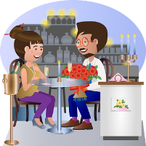




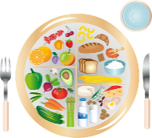


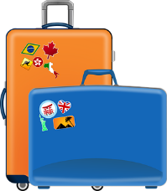




Learning Journey Map
YEAR 8 SPANISH
SKILS DEVELOPED
Move on to Year 9
Year 8 Survival Top Tips
Tip 1 | Learn and revise vocabulary regularly, approximately 20 words a week.
Tip 2 | Learn how to ask, “How do you say X?” in the language and use it often.
Tip 3 | Download relevant apps to revise: Memrise, DuoLingo, WordReference, etc.
Tip 4 | Set achievable and specific learning goals with a time limit.
Tip 5 | Allow yourself to make mistakes, even silly ones. They help you learn!
Summer Holidays
Memorise
Revise
Practise
Master
Next Level
Translation Bee Challenge
YEAR
8
Arranging to go out & making excuses
Arranging to go out using using me gustaría + infinitive.
Making excuses using “poder”& “querer”.
Discussing getting ready to go out; using reflexive verbs.
Talking about clothes; using demonstrative adjective.
Talking about sporting events; using three tenses together.
YEAR
8
Hispanic clothes competition
Introduction food
Saying what food you like; using a wider range of opinions.
Describing mealtimes; using negatives no, nunca, no… nada.
Ordering a meal; using usted / ustedes.
Describing shopping for a party; using the near future.
Given an account of a party; using three tenses together.
YEAR
8
Spanish breakfast experience
Going to the restaurant
YEAR
8
Holidays
Talking about a past holiday; using the preterite of ir/to go.
Saying what you did on holiday; using the preterite of regular -ar verbs.
Describing the last day; using the preterite of -er and –ir verbs.
Given opinions & reasons using the past; using the preterite of ser (fue- it was).
La Navidad
Christmas in Spain
All about my life
Saying what you use your phone for; using present tense of regular -ar, -ir, -er verbs.
Giving opinion about music; using me gusta + (la/ el / las/ los) the definite article.
Talking about TV and your favorite programs; using the comparative más…..que.
Talking about what you did yesterday; using the present and the preterite.
Understanding TV guide.
26th September_ European day of languages
MFL bake off competition!
YEAR
8
Applying language learning skills
* Asking and responding to questions
* Memorisation strategies (remembering more – automaticity)
* Productive skills – Writing, speaking & translation
* Receptive skills - Listening & reading
* Grammar in lesson
* Vocabulary & Phonics
* Exploring culture and language
* Communicative functions (expressing opinions)

Slide 3


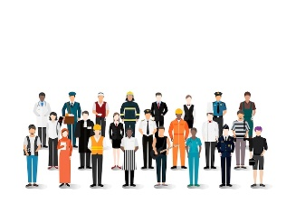

Learning Journey Map
YEAR 9 SPANISH
SKILS DEVELOPED
Move on to Year 10
Year 9 Survival Top Tips
Tip 1 | Learn and revise vocabulary regularly, approximately 20 words a week
Tip 2 | Learn how to ask, “How do you say X?” in the language and use it often
Tip 3 | Download relevant apps to revise: Memrise, DuoLingo, WordReference, etc.
Tip 4 | Set achievable and specific learning goals with a time limit
Tip 5 | Allow yourself to make mistakes, even silly ones. They help you learn!
Summer Holidays
Memorise
Revise
Practise
Master
Next Level
YEAR
9
Una aventura en Madrid- Adventure in Madrid
Meeting and greeting people; using expressions with tener.
Talking about a treasure hunt; using the superlative.
Describing a day trip; using the preterite of irregular verbs.
Discussing buying souvenirs; using tú and usted.
Discussing the final day of a visit; using three tenses.
YEAR
9
En forma- healthy lifestyle
Talking about diet; using negatives.
Talking about an active lifestyle; using stem-changing verbs.
Talking about your daily routine; using reflexive verbs.
Talking about ailments; using different verbs to describe illness.
Talking about getting fit; using se debe / no se debe.
YEAR
9
YEAR
9
¡Oriéntate!- Future study and Employment
Saying what you have to do at work ; using tener que.
Saying what job you would like to do; using correct adjective agreement.
Saying what you did at work yesterday; using the preterite tense of regular verbs.
Describing your job; using the present and the preterite together.
Somos Así- Things we like
Talking about things you like; using gustar with nouns in the present tense.
Talking about your week; using regular verbs in the present tense :verb ir.
Talking about birthday celebrations; using the near future tense.
Reading about films and understanding authentic texts/ longer, spoken texts.
YEAR
9
Applying language learning skills
* Asking and responding to questions
* Memorisation strategies (remembering more – automaticity)
* Productive skills – Writing, speaking & translation
* Receptive skills - Listening & reading
* Grammar in lesson
* Vocabulary & Phonics
* Exploring culture and language
* Communicative functions (expressing opinions)

Slide 4



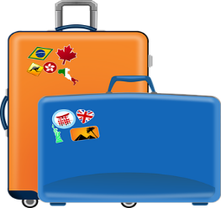
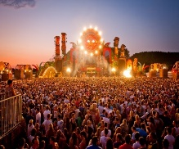
Learning Journey Map
YEAR 10 SPANISH
SKILS DEVELOPED
Move on to Year 11
Year 10 Survival Top Tips
Tip 1 | Learn and revise vocabulary regularly, approximately 30 words a week
Tip 2 | Listen to music in the target language and try to translate the lyrics
Tip 3 | Practise verb conjugation regularly: Memrise, Conjuguemos & WordReference help!
Tip 4 | Use Youtube to help you with your pronunciation: try The Mimic Method
Tip 5 | Ensure you are solid on the 100 most common words in the language
Start GCSE’s
Memorise
Revise
Practise
Master
Next Level
YEAR
10
Review Learning
Revision of topics
Exam Skills
Theme 2– lifestyle and wellbeing
Module 4/ Topic: Mi estilo de vida
Talking about food in the Spanish –Speaking countries; using adjectives of nationality.
Describing healthy daily routines; using indefinite adjectives
Talking about mealtimes and food trends; using se necesita and hay que + infinitive.
Comparing old and new habits; using the imperfect tense to say what you used to do.
Talking about illnesses and injuries; using reflexive verbs in the preterite tense and giving advice
using debes and tienes que + infinitive.
Future plans for heath and wellbeing; using the simple future tense and ‘if’ clauses.
YEAR
10
Review Learning
Revision of topics
Exam Skills
Theme 1/2 – Media & technology; My Personal World
Module 3/ Topic: Mi gente, mi mundo
Reading about different families; using possessive adjectives.
Describing people; using the present continuous and the verb ser for physical descriptions and estar for location.
Talking about who you follow on social media; using the ‘he/she/it’ form of the preterite tense.
Talking about friends and relationship; using reflexive verbs.
Talking about identity and what matters to you; using direct object pronouns.
Talking about problems and giving advice; using estar to express moods and poder and querer + infinitive.
YEAR
10
Review Learning
Revision of topics
Exam Skills
YEAR
10
Theme 6 – Travel and tourism_
Module 2/ Topic: Viajes
Discover Andalucía; using me gusta(n) / me gustaría + infinitive- (Describing a photo)
Discussing travel plans; using comparatives and se puede + infinitive.
Talking about Spanish festivals; using hay and hay que/ introducing‘if’.
Saying what you did in your last holiday; using I’ and ‘we’ forms of preterite tense verbs and using a range of structures to give opinions in the past.
Describing where did you stay; using the imperfect tense for descriptions.
Mi aventura por Latinoamérica; writing about holiday using 3 tenses.
Review Learning
Revision of topics
Exam Skills
Theme 1/2 – Media & technology; My Personal World
Module 1/ Topic: Diviértete
Talking about Spanish speaking countries; using adjectives in Spanish.
Talking about life online; using the present tense & expressions of frequency.
Talking about sports and free-time activities; revising irregular present tense verbs and using opinion verbs and expressions.
Arranging to go out; using the near future tense.
Saying what you did at the weekend; using the preterite tense.
Talking about a day that went wrong; using three tenses.
YEAR 10
SKILLS TAUGHT ACROSS ___MFL______
SPEAKING: ROLEPLAY_ PHOTOCARD & ASKING AND RESPONDING TO QUESTIONS.
WRITTEN EXPRESSION
LISTENING COMPREHENSION
READING COMPREHENSION
GRAMMAR

Slide 5

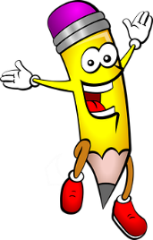




Learning Journey Map
YEAR 11 SPANISH
SKILS DEVELOPED
Year 11 Survival Top Tips
Tip 1 | Learn and revise vocabulary regularly, approximately 30 words a week
Tip 2 | Listen to music in the target language and try to translate the lyrics
Tip 3 | Practise verb conjugation regularly: Memrise, Conjuguemos & WordReference help!
Tip 4 | Use Youtube to help you with your pronunciation: try The Mimic Method
Tip 5 | Ensure you are solid on the 100 most common words in the language
Next Level
Exams & End of GCSEs
YEAR
11
Review Learning
Revision of topics
Exam Skills
Exam preparation @ topical review
Theme 1_Identity and Culture
Theme 2_Local area, holiday and travel
Theme 3 _ School
Theme 4 _Future aspirations, study and work
Theme 5_International and global dimensions
Productive skills- Speaking, writing and translations
Receptive skills_ Listening & reading strategies
Grammar_ (tenses, intensifiers, connectives , time phrases and higher complex phrases )
YEAR
11
Review Learning
Revision of topics
Exam Skills
Exam preparation @ topical review
Theme 1_Identity and Culture
Theme 2_Local area, holiday and travel
Theme 3 _ School
Theme 4 _Future aspirations, study and work
Theme 5_International and global dimensions
Productive skills- Speaking, writing and translations
Receptive skills_ Listening & reading strategies
Grammar_ (tenses, intensifiers, connectives , time phrases and higher complex phrases )
YEAR
11
Review Learning
Revision of topics
Exam Skills
YEAR
11
Theme 5 : International and global dimensions- Hacia un mundo mejor
Describing type o houses using adjectival agreement.
Talking about environment; Se debería + infinitive.
Healthy eating and diet related problems; using present and near future tenses together.
Using superlative and the present subjunctive to talk about global issues.
Voluntary work and experiences.
Using modal verbs/ conditional tense to talk about what the government should do to help.
Review Learning
Revision of topics
Exam Skills
Theme 1 : _Identity and Culture_ Mi gente
Talking about socializing and family; using para with infinitives
Describing people; using adjectival agreement.
Talking about friends and family; revising possessive adjectives (mi, tu, su, nuestro, vuestro, su) and using verbs in the present tense.
Talking about social networks.
Talking about reading preferences; using a range of connectives and cognising similar ideas expressed differently.
Theme 1 : Identity and Culture_ intereses e influencias
Talking about free-time activities using different tenses.
Giving opinions about TV programs and films; using adjectival agreement.
Talking about what you usually do; using soler + infinitive.
Talking about sports; using the imperfect tense to say what you used to do.
YEAR 11
SKILLS TAUGHT ACROSS ___MFL______
SPEAKING: ROLEPLAY_ PHOTOCARD & ASKING AND RESPONDING TO QUESTIONS.
WRITTEN EXPRESSION
LISTENING COMPREHENSION
READING COMPREHENSION
GRAMMAR

